Slide 1
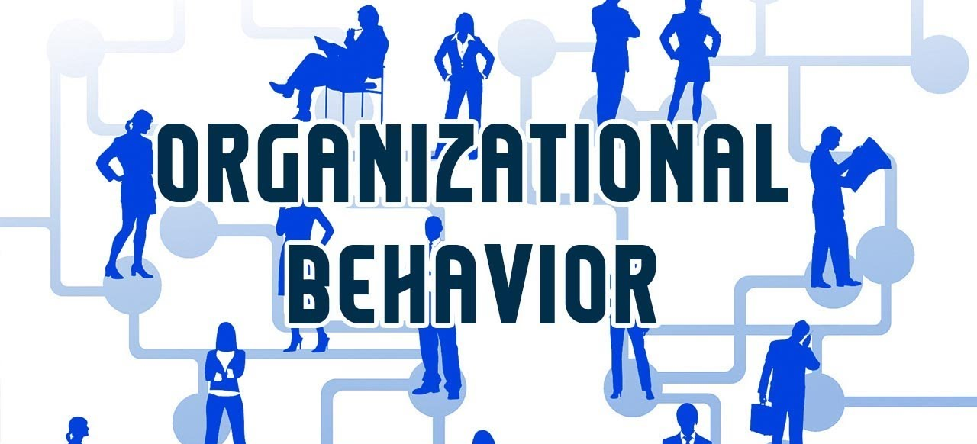


Emotions and Moods
Instructor: Dr. Muhammad Rafiq
Chapter 4: Organizational Behavior – 15th Edition

Slide 2
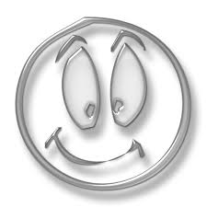


Emotions Why Emotions Were Ignored in OB?
The “Myth of Rationality”
Emotions were seen as irrational
Managers worked to make emotion-free environments
View of Emotionality
Emotions were believed to be disruptive
Emotions interfered with productivity
Only negative emotions were observed
Now we know emotions can’t be separated from the workplace
Notes:
The “myth of rationality”
- Emotions were the antithesis of rationality and should not be seen in the workplace.
- Organizations are not emotion-free.
Emotions of any kind are disruptive to organizations.
Original OB focus was solely on the effects of strong negative emotions that interfered with individual and organizational efficiency.
Historically the study of organizational behavior has not given much attention to emotions. Emotions were typically seen as irrational so managers tended to work to make the workplace emotion-free.
Often managers viewed emotions as disruptive to the workplace and therefore a hindrance to productivity. However, when thinking about emotions, typically managers were focusing on negative emotions. Even though there are some negative emotions that could hinder productivity, there is no doubt that workers bring their emotions to the workplace. Therefore, any study in organizational behavior would not be complete without considering the roles of emotions in the workplace.

Slide 3
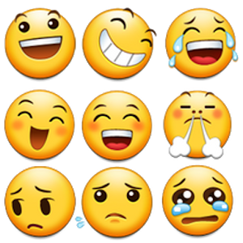
What Are Emotions?
Affect
Emotions
Moods
A broad range of emotions that people experience.
Feelings that tend to be less intense than emotions and that lack a contextual stimulus.
Intense feelings that are directed at someone or something.
Notes:
Affect is a generic term that covers a broad range of feelings people experience, including both emotions and moods. Emotions are intense feelings directed at someone or something. Moods are less intense feelings than emotions and often (though not always) arise without a specific event acting as a stimulus.
Affect is a generic term that covers a broad range of feelings people experience. This includes both emotions and moods. Emotions are intense feelings that are directed at someone or something. Moods are the feelings that tend to be less intense than emotions and that lack a contextual stimulus.

Slide 4
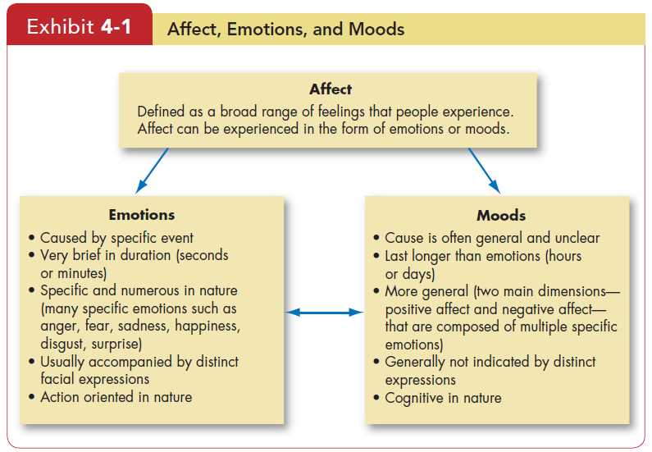

Slide 5
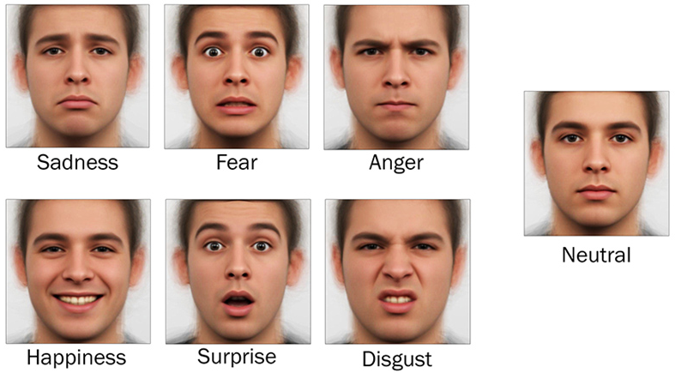
Basic Emotions
Happiness
Surprise
Fear
Sadness
Anger
Disgust
Notes:
Not all psychologists agree; however, there do seem to be six basic emotions that emerge in studies: anger, fear, sadness, happiness, disgust, surprise. All other emotions fall under these six. Some psychologists even place these basic six on a spectrum of emotion.

Slide 6


Sources of Emotion and Mood
Personality
There is a trait component – affect intensity
Day and Time of the Week
There is a common pattern for all of us
Happier in the midpoint of the daily awake period
Happier toward the end of the week
Weather
Illusory correlation – no effect
Stress
Even low levels of constant stress can worsen moods
Social Activities
Physical, informal, and dining activities increase positive moods
Notes:
There are many things that impact our mood and emotions. Personality is a key component and will definitely impact the intensity of the emotions we feel. The day and time of the week is a common pattern for all of us. Many are happier toward the end of the week. Weather is thought to have an impact on our emotions, but there is no proven effect.
Stress is an important factor and even at low levels it can cause our mood to change. It is important to maintain a low level of stress to help us control our psychological as well as our physical health. Social activities have been shown to have a positive impact on our moods. This could be physical outlets such as playing in a basketball league or it can be going out to dinner with friends. These types of activities are found to have a positive impact on our mood.

Slide 7
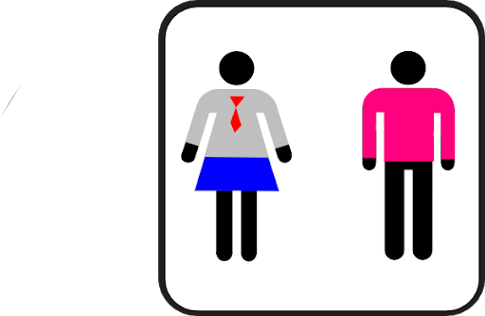
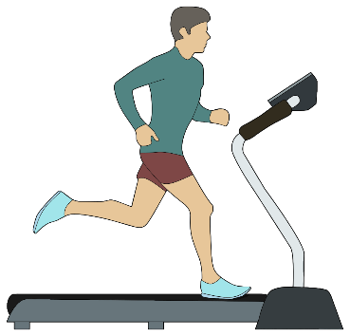
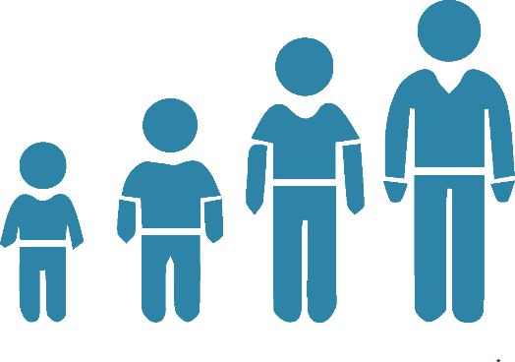
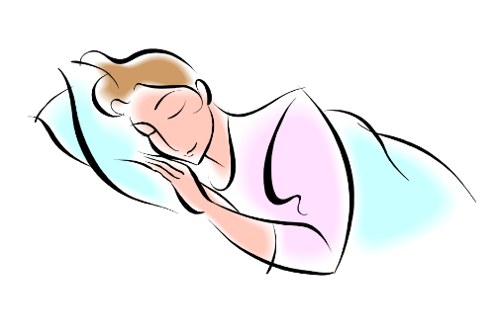
More Sources of Emotion and Mood
Sleep
Poor sleep quality increases negative affect
Exercise
Does somewhat improve mood, especially for depressed people
Age
Older folks experience fewer negative emotions
Gender
Women vs. men
Notes:
Some additional sources of emotion and mood include such factors as sleep and exercise. It is important to get enough and high-quality levels of sleep. Physical activity can also aid in keeping our moods upbeat.
Some characteristics that are beyond our control can impact our moods, such as age and gender. Elderly people tend to have fewer negative emotions. Women tend to express their emotions readily and their moods tend to last longer. Research has shown that this is due more to cultural socialization than to biology.

Slide 8
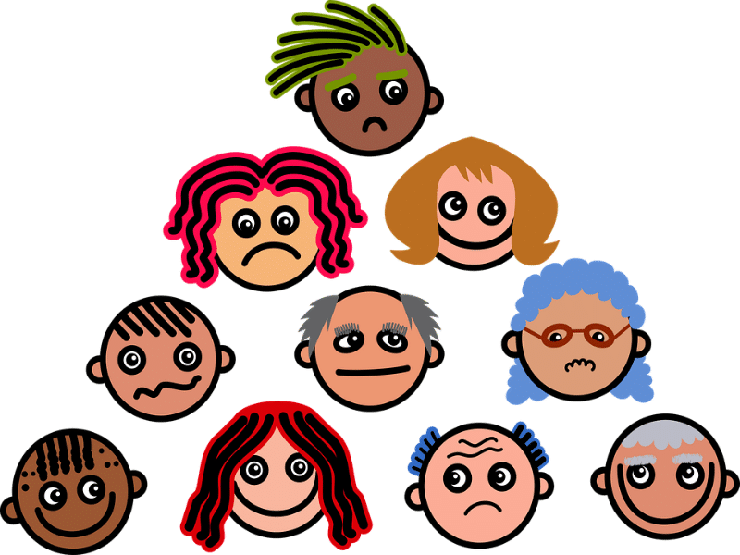
Gender and Emotions
Women
Can show greater emotional expression.
Experience emotions more intensely.
Display emotions more frequently.
Are more comfortable in expressing emotions.
Are better at reading others’ emotions.
Men
Believe that displaying emotions is inconsistent with the male image.
Are less able to read and to identify others’ emotions.
Have less need to seek social approval by showing positive emotions.
Video: https://www.youtube.com/watch?v=SZ6mVumHY9I

Slide 9
External Constraints on Emotions
Organizational Influences
Cultural Influences
Individual Emotions

Slide 10
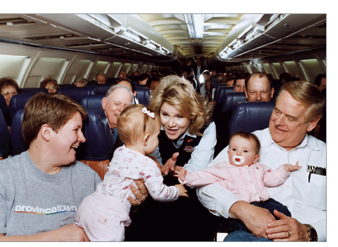

Emotional Labor
Emotional Labor
An employee’s expression of organizationally desired emotions during interpersonal transactions at work.
Emotional Dissonance:
Employees have to project one emotion while simultaneously feeling another
Can be very damaging and lead to burnout.
Notes:
Emotional labor is the process of managing feelings and expressions to fulfill the emotional requirements of a job. More specifically, workers are expected to regulate their emotions during interactions with customers, co-workers and superiors.
Job burnout is a special type of job stress — a state of physical, emotional or mental exhaustion combined with doubts about your competence and the value of your work
In many jobs there is an implied agreement on the types of emotions that should be expressed. For example, waitresses are supposed to be friendly and cheerful, whether they are currently feeling that emotion or not. When employees don’t feel the emotion they are required to express, they may experience emotional dissonance. This can lead to burnout and frustration with the job.

Slide 11


Types of Emotions
Felt Emotions
An individual’s actual emotions.
Actual Feelings, In-born, Natural Response
Displayed Emotions
Emotions that are organizationally required and considered appropriate in a given job.
Surface Acting: displaying appropriately but not feeling those emotions internally
Deep Acting: changing internal feelings to match display rules - very stressful
Notes:
An employee’s actual emotions are their felt emotions and this is in contrast to the emotions that are required or deemed appropriate, which are called displayed emotions. There are two levels of displayed emotions that can be expressed. They are both appropriately called acting. Surface acting is when an employee displays the appropriate emotions even when they don’t feel those emotions. Deep acting is when the employee actually changes their internal feelings to match displayed rules; this level of acting can be very stressful.

Slide 12
Affective Events Theory (AET)
An event in the work environment triggers positive or negative emotional reactions
Personality and mood determine response intensity
Emotions can influence a broad range of work performance and job satisfaction variables.
Implications of the theory:
Individual response reflects emotions and mood cycles.
Current and past emotions affect job satisfaction.
Emotional fluctuations create variations in job satisfaction and performance.
Both negative and positive emotions can distract workers and reduce job performance.
Notes:
Affective Events Theory demonstrates that employees react emotionally to things that happen to them at work and this can influence their job performance and job satisfaction. The intensity of these responses will be based on emotion and mood.
AET has a number of implications. These implications are as follows:
When an employee has an emotional episode, it is actually the result of a series of emotional experiences that are triggered by a single event.
Your job satisfaction is impacted by current and past emotions.
As your emotions fluctuate over time, it will create variations in job performance.
Behaviors that are driven by emotions are typically brief and variable.
Both positive and negative emotions can distract workers and reduce job performance.
In summary, emotions do provide very valuable information and predict factors about behavior. In addition, it is important not to ignore minor events as they will accumulate over time.

Slide 13
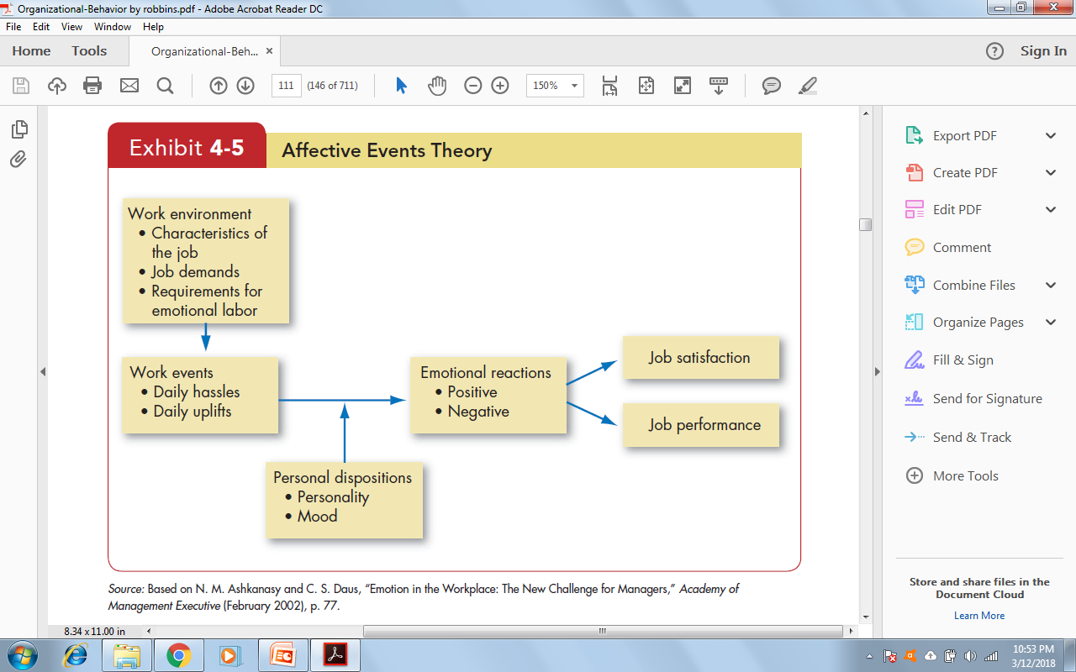
Affective Events Theory (AET)
Affective Events Theory (AET) demonstrates that employees react
emotionally to things that happen to them at work, and this reaction influences their job performance and satisfaction.

Slide 14
What Is the Function of Emotion?
Emotions can aid in our decision-making process. Many researchers have shown that emotions are necessary for rational decisions.
Thinking
Decision Making
Feeling
Emotions provide valuable insights about behavior.
Emotions, and the minor events that cause them, should not be ignored at work; they accumulate.
Notes:
There are some who think that emotions are linked to irrationality and that expressing emotions in public may be damaging to your career or status. However, research has shown that emotions are necessary for rational thinking. They help us make better decisions and help us understand the world around us. If we are going to make decisions, we need to incorporate both thinking and feeling.

Slide 15
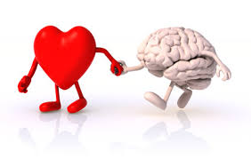
Part-I Emotional Intelligence: A Key to success

Slide 16
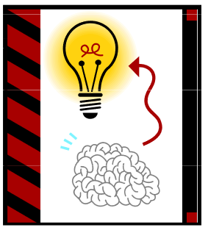
What is Emotional INTELLIGENCE
Emotional intelligence is your ability to recognize and understand emotions and your skill at using this awareness to manage yourself and your relationship with others.

Slide 17
Why emotional intelligence
Academic intellect isn’t enough
Technical proficiency doesn’t win the price
IQ
EQ
Gets you hire
Gets you Promote

Slide 18
Why emotional intelligence
Research has shown the following facts:
90% of top performers are high in EQ.
75% of careers are derailed for reasons related to emotional competence
Emotional intelligence is the basic difference between a good leader and excellent leader
In order to develop an ability to let your feelings guide you what is important to think about
In order to develop the ability to use our feelings to help us make better decisions
In order to ensure the feeling do not control reactions before the brain has the chances to fully process the information

Slide 19
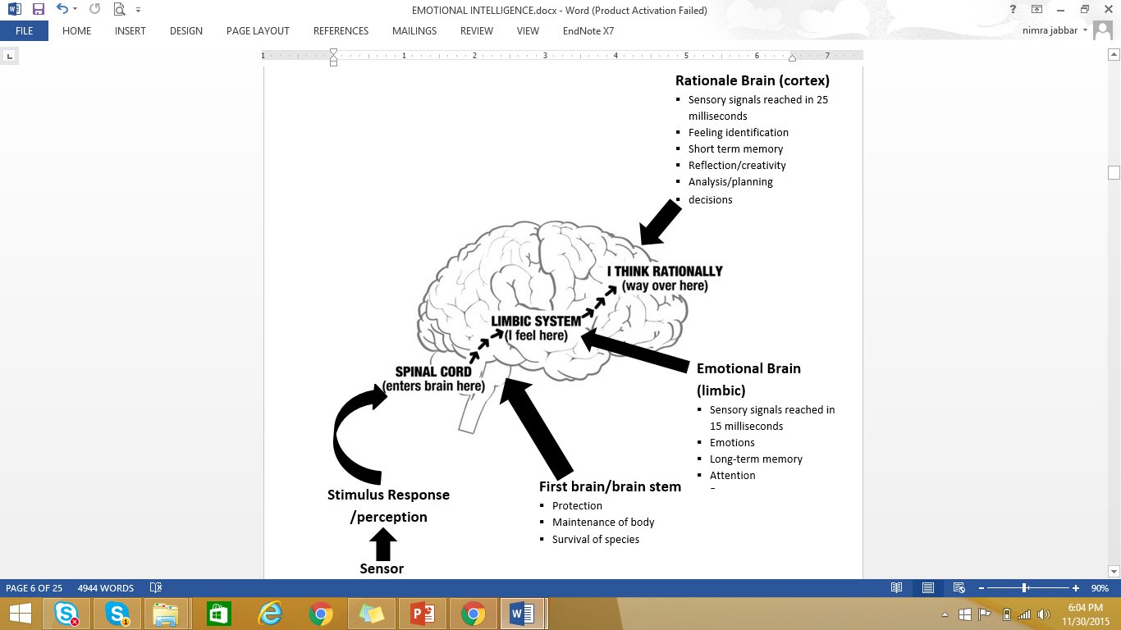
Technicalities of emotional intelligence – the biological approach

Slide 20
An Amygdala Hijack!!
You know that you’ve been hijacked when…
Emotions control your thinking and actions.
You are thinking and acting against your own will!
You are unable to accurately read others’ emotions
You can’t find the right words . . . (stumbling when you try to speak)
You are unable to focus your thinking or actions
Your “fight or flight” response kicks in . . . heart races, blood pressure increases, sweating profusely, uneasy feeling in the “gut,” clenched jaw, twitching, tapping foot, cold extremities as the brain rushes blood to muscles needed for fighting or fleeing . . .

Slide 21





Understanding and managing emotions
Identification of emotions means we can describe what is happening, we can label our feelings and others and we can communicate and discuss these emotions. There are five core feelings in which all other emotions are rooted. Happiness, sadness, anger, fear and shame.
Happy
Sad
Fear
Surprised
Anger

Slide 22
Emotional intelligence skills
What I see
What I do
Self-awareness
Can I accurately identify my emotions as they happen?
Self-management
Can I manage my emotions and behavior to a positive outcome?
Personal competence
Social awareness
Can I accurately identify your emotions and tendencies as I interact with you or a group?
Relationship management
Can I mange the interaction I have with others constructively and to a positive outcome?
Social competence

Slide 23
Emotional intelligence competencies
Recognition
Regulation
Self-awareness
Emotional self-awareness
Accurate self-assessment
Self-confidence
Self-management
Emotional self-control
Transparency
Adaptability
Achievement orientation
Initiative
Optimism
Personal competence
Social awareness
Empathy
Organizational awareness
Service orientation
Relationship management
Influence
Developing others
Inspirational Leadership
Change catalyst
Conflict management
Teamwork and collaboration
Social competence

Slide 24
OB Applications of Emotions and Moods
Selection
EI should be a hiring factor, especially for social jobs.
Decision Making
Emotions are an important part of the decision-making process in organizations. Positive emotions can lead to better decisions.
Creativity
Positive mood increases flexibility, openness, and creativity.
Motivation
Positive mood and emotional commitment to work is highly linked to motivation and expectations of success; feedback amplifies this effect.
Leadership
Emotions are important to acceptance of messages from organizational leaders.
Notes:
There are numerous applications of emotions and moods. These include selection of employees, decision making, creativity, motivation, and leadership.
Selection – Employers should consider EI a factor in hiring for jobs that demand a high degree of social interaction
Decision Making – Positive emotions can increase problem-solving skills and help us understand and analyze new information
Creativity – Positive moods and feedback may increase creativity.
Motivation – Promoting positive moods may give a more motivated workforce
Leadership – Emotions help convey messages more effectively

Slide 25
More OB Applications of Emotions and Moods
Negotiation
Emotions can impair negotiations. Skillfully displayed emotions can affect negotiations.
Customer Services
Emotions affect service quality delivered to customers which, in turn, affects customer relationships
Emotional Contagion: “catching” emotions from others
Job Attitudes
Can carry over to home, but dissipate overnight
Deviant Workplace Behaviors
Negative emotions lead to employee deviance (actions that violate norms and threaten the organization)
Productivity failures
Property theft and destruction
Political actions
Personal aggression
Notes:
Some additional applications of emotions and mood include negotiation, customer service, job attitudes, deviant workplace behaviors, and manager’s influence.
Negotiation – Emotions may impair negotiator performance
Customer Service – Customers “catch” emotions from employees, called emotional contagion. Emotional contagion is the phenomenon of having one person's emotions and related behaviors directly trigger similar emotions and behaviors in other people.
Job Attitudes – Emotions at work get carried home but rarely carry over to the next day
Deviant Workplace Behaviors – Those who feel negative emotions are more likely to engage in deviant behavior at work

Slide 26


How Can Managers Influence Moods?
Use humor to lighten the moment
Give small tokens of appreciation
Stay in a good mood themselves – lead by example
Hire positive people

Slide 27

Global Implications
Do people experience emotions equally?
No. Culture can determine type, frequency, and depth of experienced emotions.
Do people interpret emotions the same way?
Yes. Negative emotions are seen as undesirable and positive emotions are desirable. However, value of each emotion varies across cultures
Do norms of emotional expression vary?
Yes. Some cultures have a bias against emotional expression; others demand some display of emotion.
How the emotions are expressed may make interpretation outside of one’s culture difficult .
Notes:
Across cultures there do not seem to be differences in how people experience emotions. However, it is shown that in different cultures there are different interpretations of emotions. Some cultures are more accepting of emotional expression than others. When you are engaging with other cultures, be sure to understand their cultural norms.

Slide 28
Implications for Managers
Understand the role of emotions and moods to better explain and predict behavior
Emotions and moods do affect workplace performance
While managing emotions may be possible, absolute control of worker emotions is not

Slide 29
Keep in Mind…
Positive emotions can increase problem-solving skills
People with high EI may be more effective in their jobs
Managers need to know the emotional norms for each culture they do business with

